Slide 1
Fragments
Lecture 5.1
Tom Karni, Itsik Avidan

Slide 2
A Fragment represents a behavior or a portion of user interface in an Activity.
Combine multiple fragments
Reuse a fragment in multiple activities
Fragment's lifecycle is directly affected by the host activity's lifecycle
Can add or remove fragments when activity is running

Slide 3
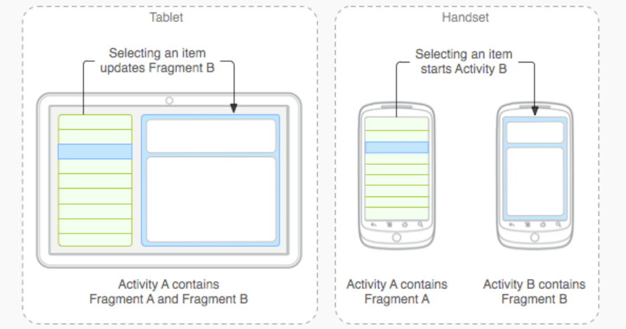
Design
Design for reuse
Avoid directly manipulating one fragment from another fragment

Slide 4
Backwards compatibility
Available as part of the OS form Android 3.0 (API level 11)
Older versions can use the support library located in the sdk under: extras -> android -> support The .jar file should be imported into the project.

Slide 5
Subclasses
DialogFragment alternative to using the activity’s dialog helper methods
PreferencesFragment useful when creating a "settings" activity for your application
ListFragment Displays a list of items that are managed by an adapter

Slide 6
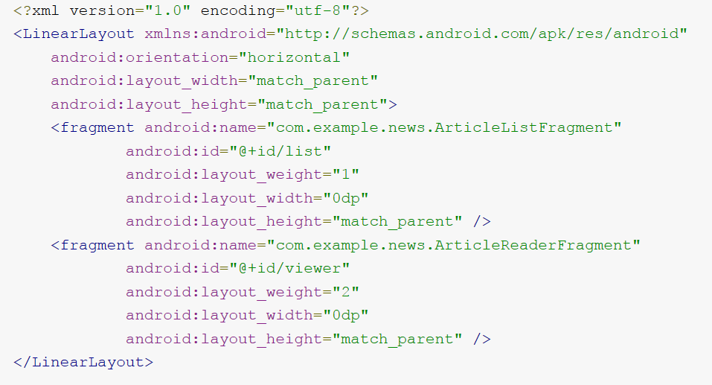
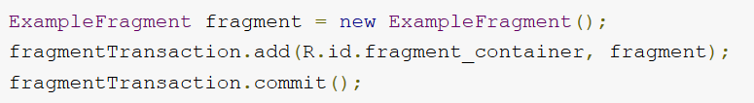
Insert a fragment
<fragment> element in the layout file
Add to an existing ViewGroup in code
Invisible worker (without ui)

Slide 7
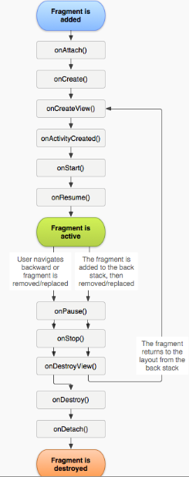
Lifecycle
onCretae() initialize essential components
onCreateView() draw its user interface must return a View
onPause() commit any changes that should be persisted

Slide 8
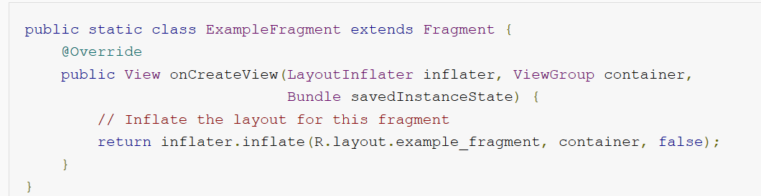
Create
LayoutInflater - inflate a layout from a layout resource defined in XML
ViewGroup - from the activity's layout in which your fragment layout will be inserted
Bundle - provides data about the previous instance of the fragment, if the fragment is being resumed

Slide 9
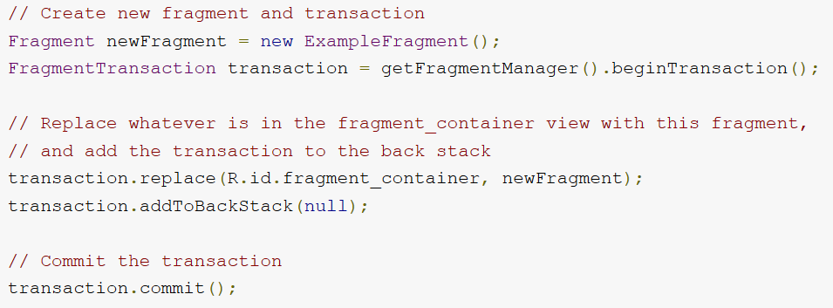
Transactions
Add, remove, replace
Add to back-stack

Slide 10
Communicate with activity
From a fragment: getActivity()
From an activity: getFragmentManager().findFragmentById(R.id.example_fragment);
event callbacks to the activity: define a callback interface inside the fragment and require that the host activity implement it.

Slide 11
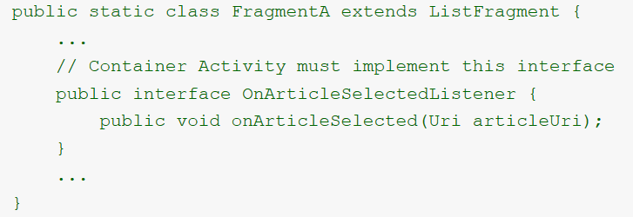
Communicate with activity
OnArticleSelectedListener interface is declared inside fragment A

Slide 12
Communicate with activity
fragment A's onAttach() callback method (which the system calls when adding the fragment to the activity) instantiates an instance of OnArticleSelectedListener by casting the Activity that is passed into onAttach()
mListener member holds a reference to activity's implementation of OnArticleSelectedListener
public static class FragmentA extends ListFragment {
OnArticleSelectedListener mListener;
...
@Override
public void onAttach(Activity activity) {
super.onAttach(activity);
try {
mListener = (OnArticleSelectedListener) activity;
} catch (ClassCastException e) {
throw new ClassCastException(activity.toString() + " must implement OnArticleSelectedListener");
}
}
...
}

Slide 13
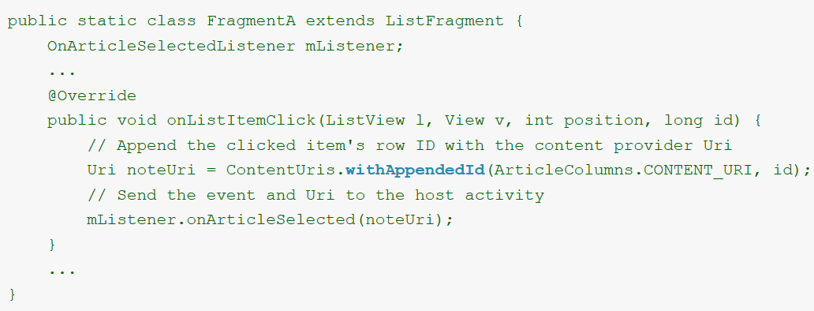
Communicate with activity
the activity that hosts the fragment implements the OnArticleSelectedListenerinterface and overrides onArticleSelected() to notify fragment B of the event from fragment A.

